Slide 1
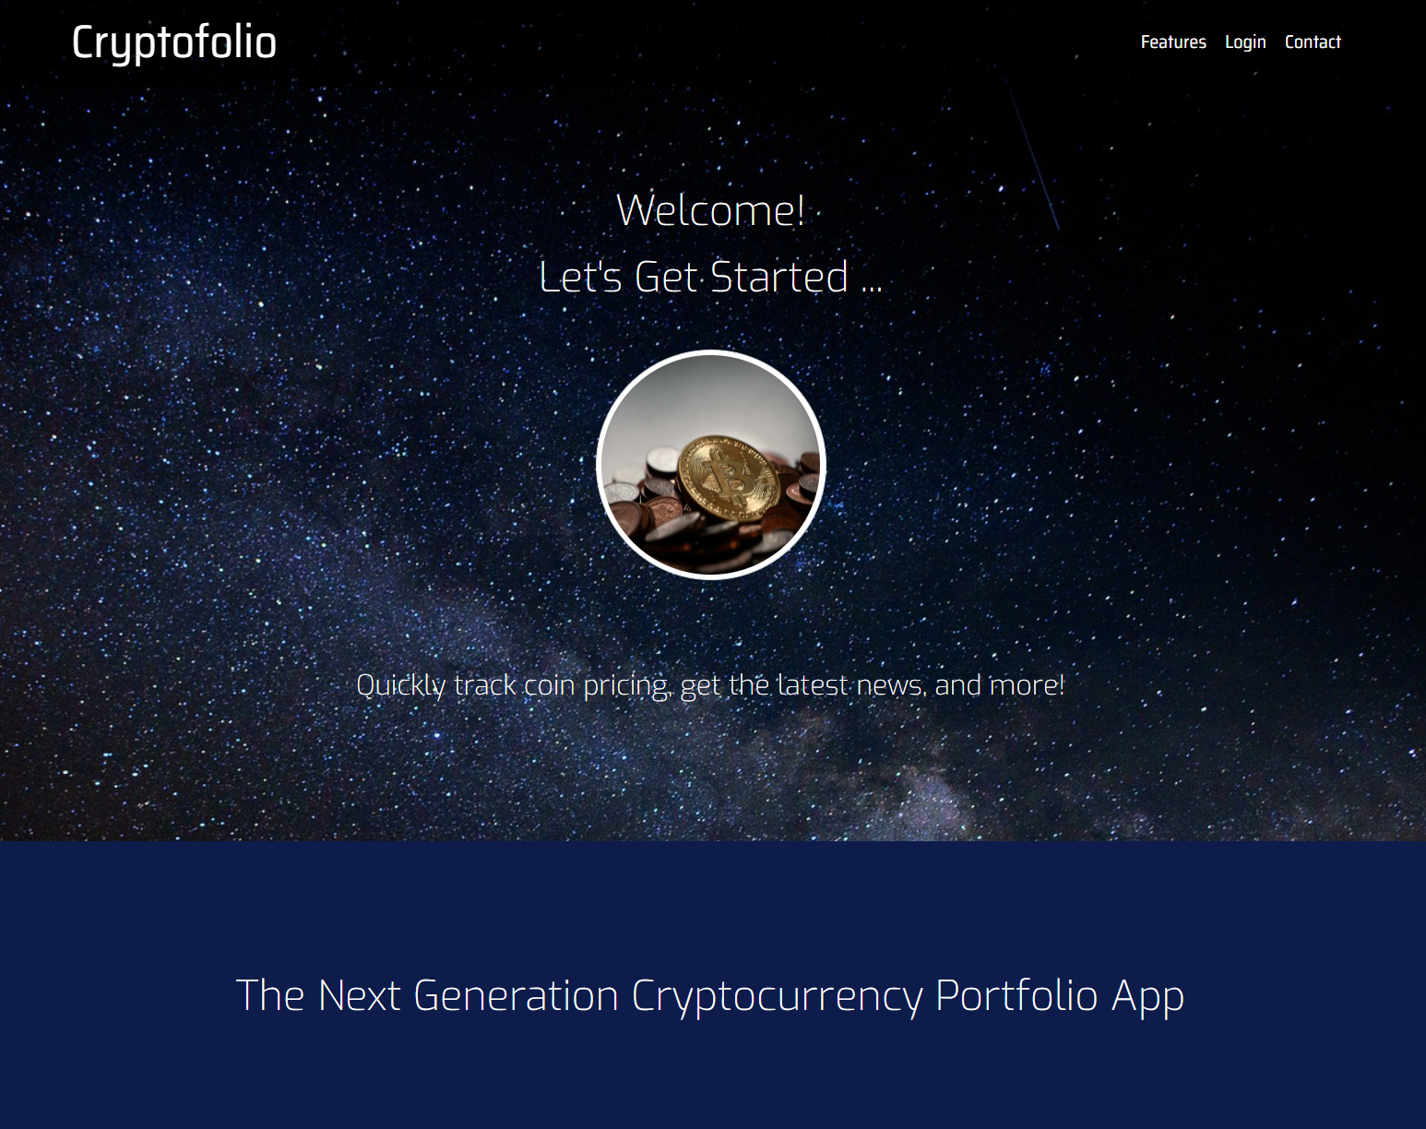
Cryptofolio
____
cryptocurrency portfolio management
Notes:
This is a test for notes screen

Slide 2
Team
Hodlers
_____
Vicki Hope
Kevin Luu
Alton Salmon
What’s a Hodler?
Concept
Cryptocurrency
Portfolio Manager
easy-to-use web service providing:
current market price for five popular cryptocurrencies for past seven days:
Bitcoin, Ethereum, Litecoin,
Monero and Ripple
Latest cryptocurrency news using Cryptocompare API
Portfolio management simulation:
user authentication
buy/sell any of the five supported cryptocurrencies
Motivation
Meet project requirements
Simulate real-world experience
Challenge coding and project skills
Build topic knowledge
Create foundation for marketable product

Slide 3

DESIGN PROCESS Two coders and a Dietitian
Brainstorm ideas/Select One
Determine MVP/Pseudocode
Create/Assign Project Tasks

Slide 4
Design Process
Minimum Viable Product (MVP)
Pseudocode
Meet coding/presentation requirements
User can view pricing for 5 cryptocurrencies (API)
User can view latest cryptocurrency news (API)
One portfolio per user
Create portfolio by simulating buy/sell cryptocurrency
Graphically represent coin pricing (7 days)
Graphically represent portfolio holdings by coin
Modern User Interface
Share MVP in proposal.md file in project
High level – talk through of parts and pieces
Define flow/layout of website
Define database needs/layout (one database, 3 tables)
Where/how/type of charts to add (chart.js)
Where/how to add user authentication (passport-jwt)
State business logic for buying/selling currency

Slide 5
Design Process
Workflow
Workflow (continued)
User launches app, presented with modern UI
UI provides option to login
Login authentication determines if user gains access
If authorized, user views dashboard:
Current seven-day pricing for five cryptocurrencies
Portfolio total and coin distribution
Latest cryptocurrency news
Most recent transactions
User also views left-side menu options:
Buy/Sell (simulate buy/sell any of 5 supported coins)
Accounts (list of ALL transactions for user)
Tools (future – disable)
Settings (update user credentials – email, password)

Slide 6
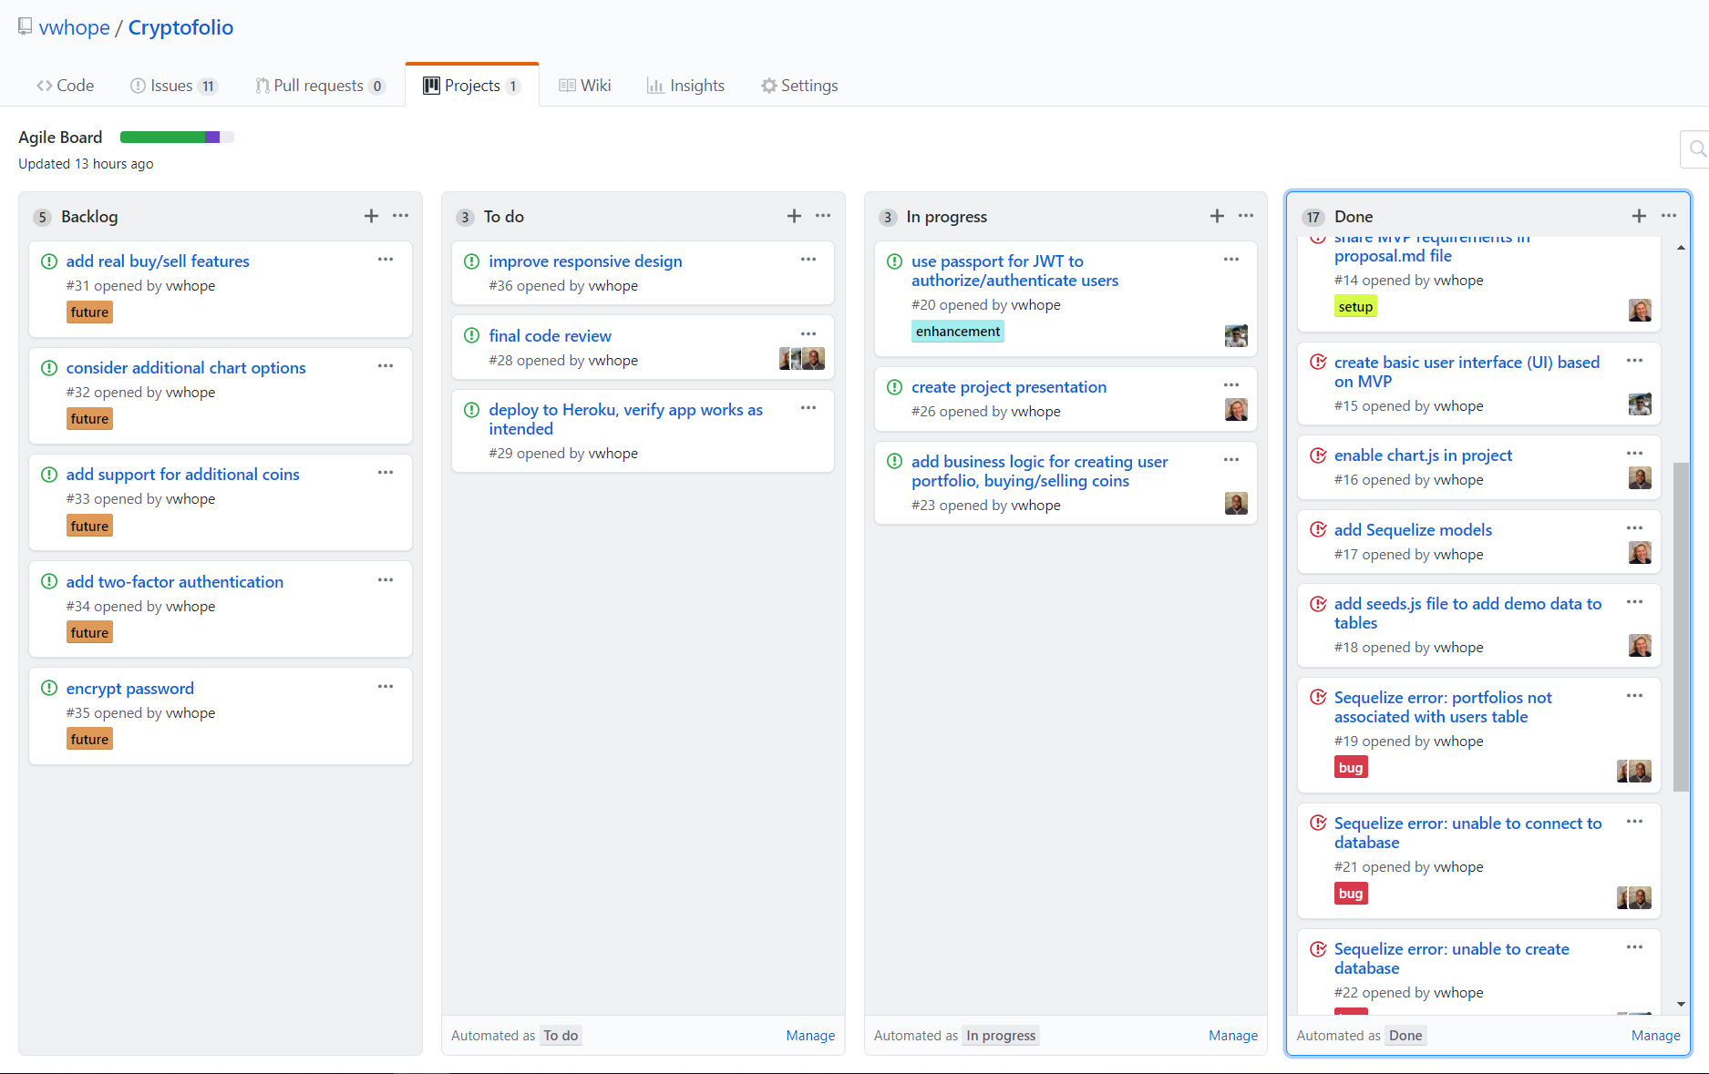
Design Process
Task Assignments
Vicki
GitHub repo/project organizer/Agile board
UI – Splash page
Database – create models/associations/seed data
Project presentation
Alton
Implement chart.js (line/pie)
Sequelize queries
Back-end business logic (add/sell coins)
Kevin
Create initial dashboard UI to build upon (this got us started)
Implement express-handlebars partials
Implement passport-JWT authentication
Interface and design for business logic (add/sell coins)
Agile Board – organize, track, comment on project progress

Slide 7
Tech Requirements
JavaScript
Node.js
Express
Express-handlebars
MySQL
Sequelize ORM
Software
Design
Process
Model View Controller design pattern
new technology/modules
(chart.js, passport-jwt)
CRUD database operations
RESTful routes
Project Setup - GitHub
eslint/prettier
Travis-ci
.env (API keys), cross-env
.editorconfig
Agile Board
Testing (Chai/Mocha)
Heroku Deployment

Slide 8
Sequelize
Object-Relational Mapping - (ORM)
Terminology for Table Associations:
Primary Key for Users table is: email
Foreign Key in Trans/Port tables: email
A user hasMany records in Portfolio
A user hasMany records in Transaction
Transaction belongsTo User
Portfolio belongsTo User
When user buys/sells coins both the transactions and portfolios tables are updated.
Splash Page
Click login
FAIL
User
authentication
PASS
Users Table
Transactions Table
Portfolios Table
authenticated endpoints

Slide 9
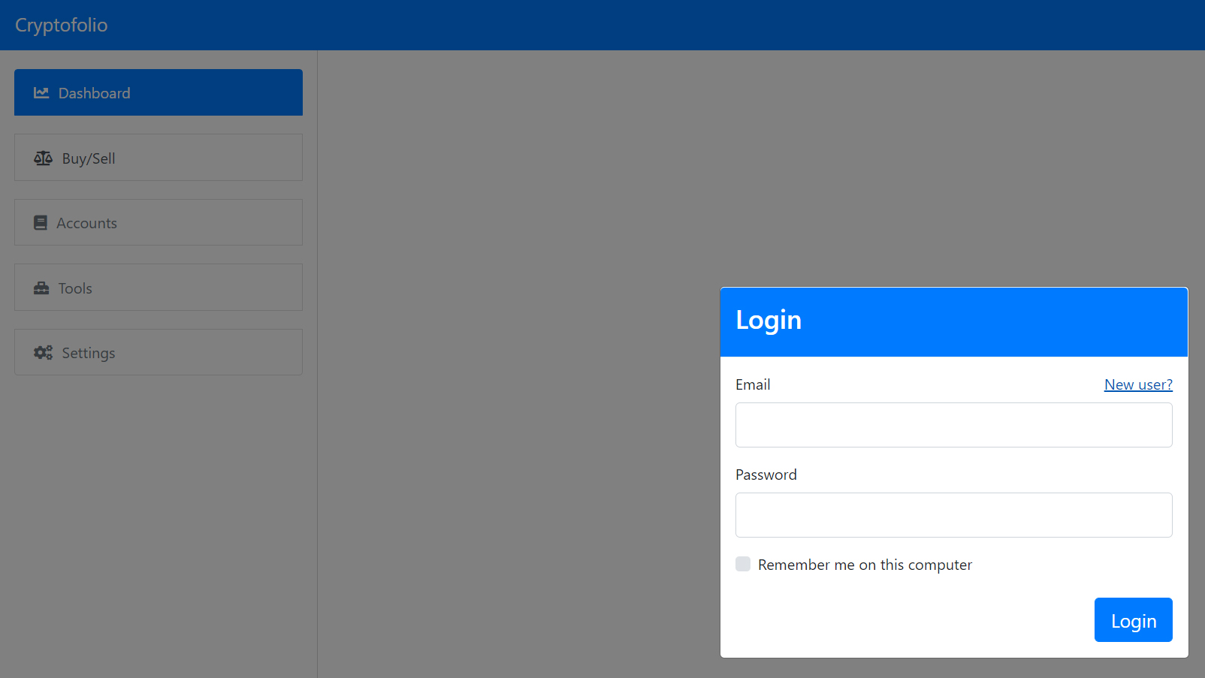
Passport - jwt
Provides strategy for authenticating endpoints with JSON web tokens
Setup passport as middleware: server.js
Define local and JWT strategies and export them
auth/auth.js
Store secret and session settings
auth/config.js
Apply authentication to routes:
api.js – data access - authenticate user, get token
html.js – page/route access - authenticate /trade route
For more information, visit: http://www.passportjs.org/packages/passport-jwt/

Slide 10
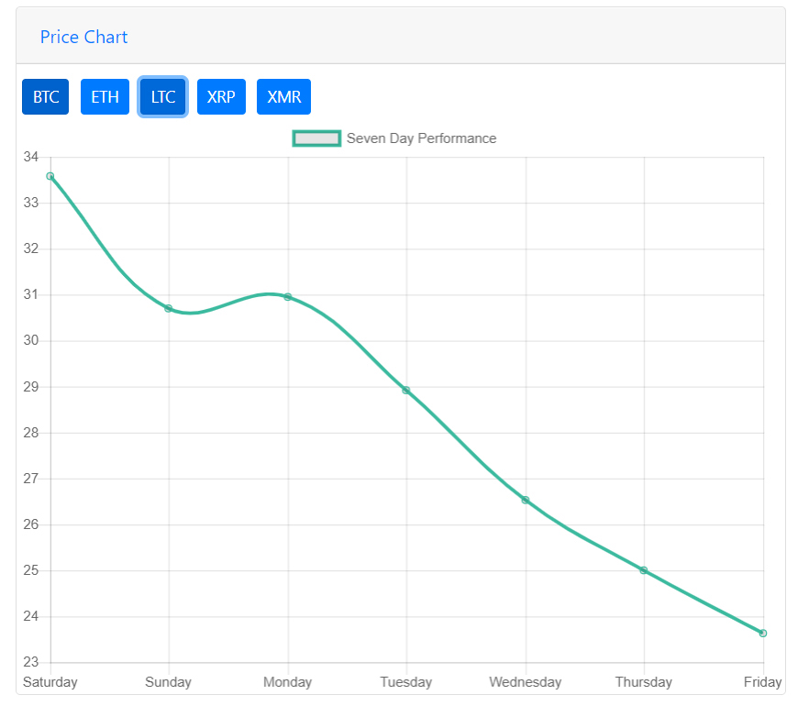
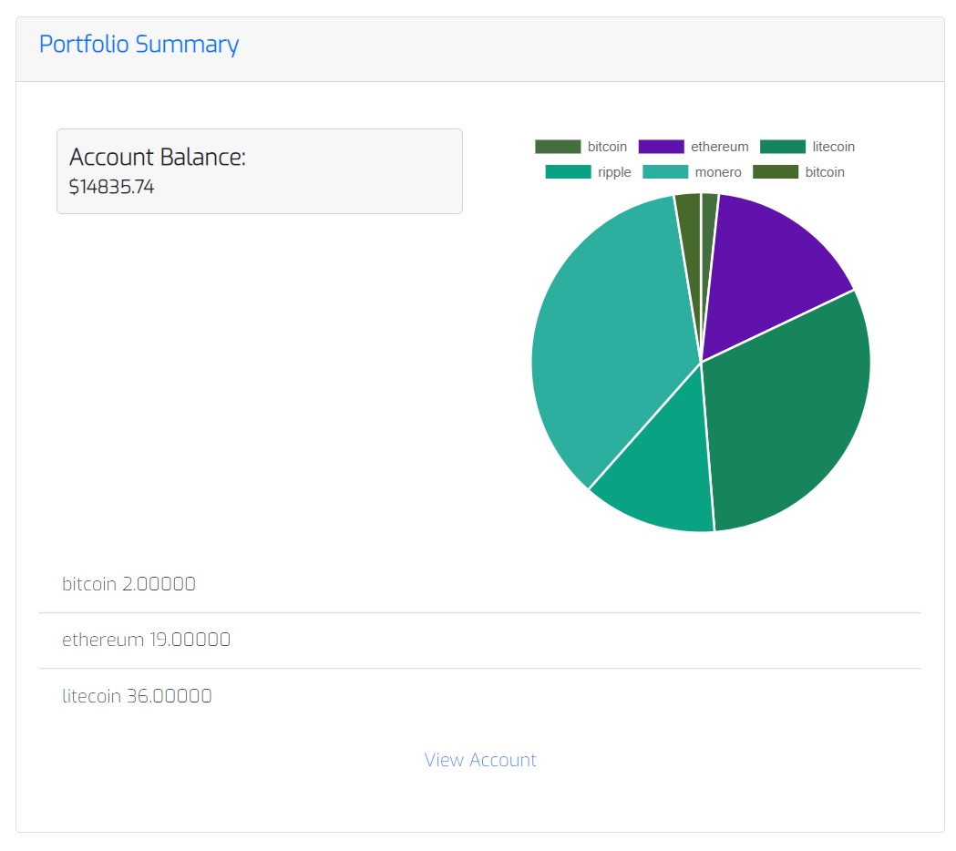
CHART.JS
Coin Price for Last Seven Days - by Coin
User’s Portfolio Holdings by Coin
For more information, visit: https://www.chartjs.org/docs/latest/

Slide 11

Future Development
Not Yet Ready for Prime-time
SECURITY
Encrypt password
Add two-factor authentication
REAL-WORLD FUNCTIONALITY
real buy/sell features
support for additional coins
DESIGN & BRANDING
Consider additional chart options
Update UI based on enhancements/branding
100% responsive design

Slide 12
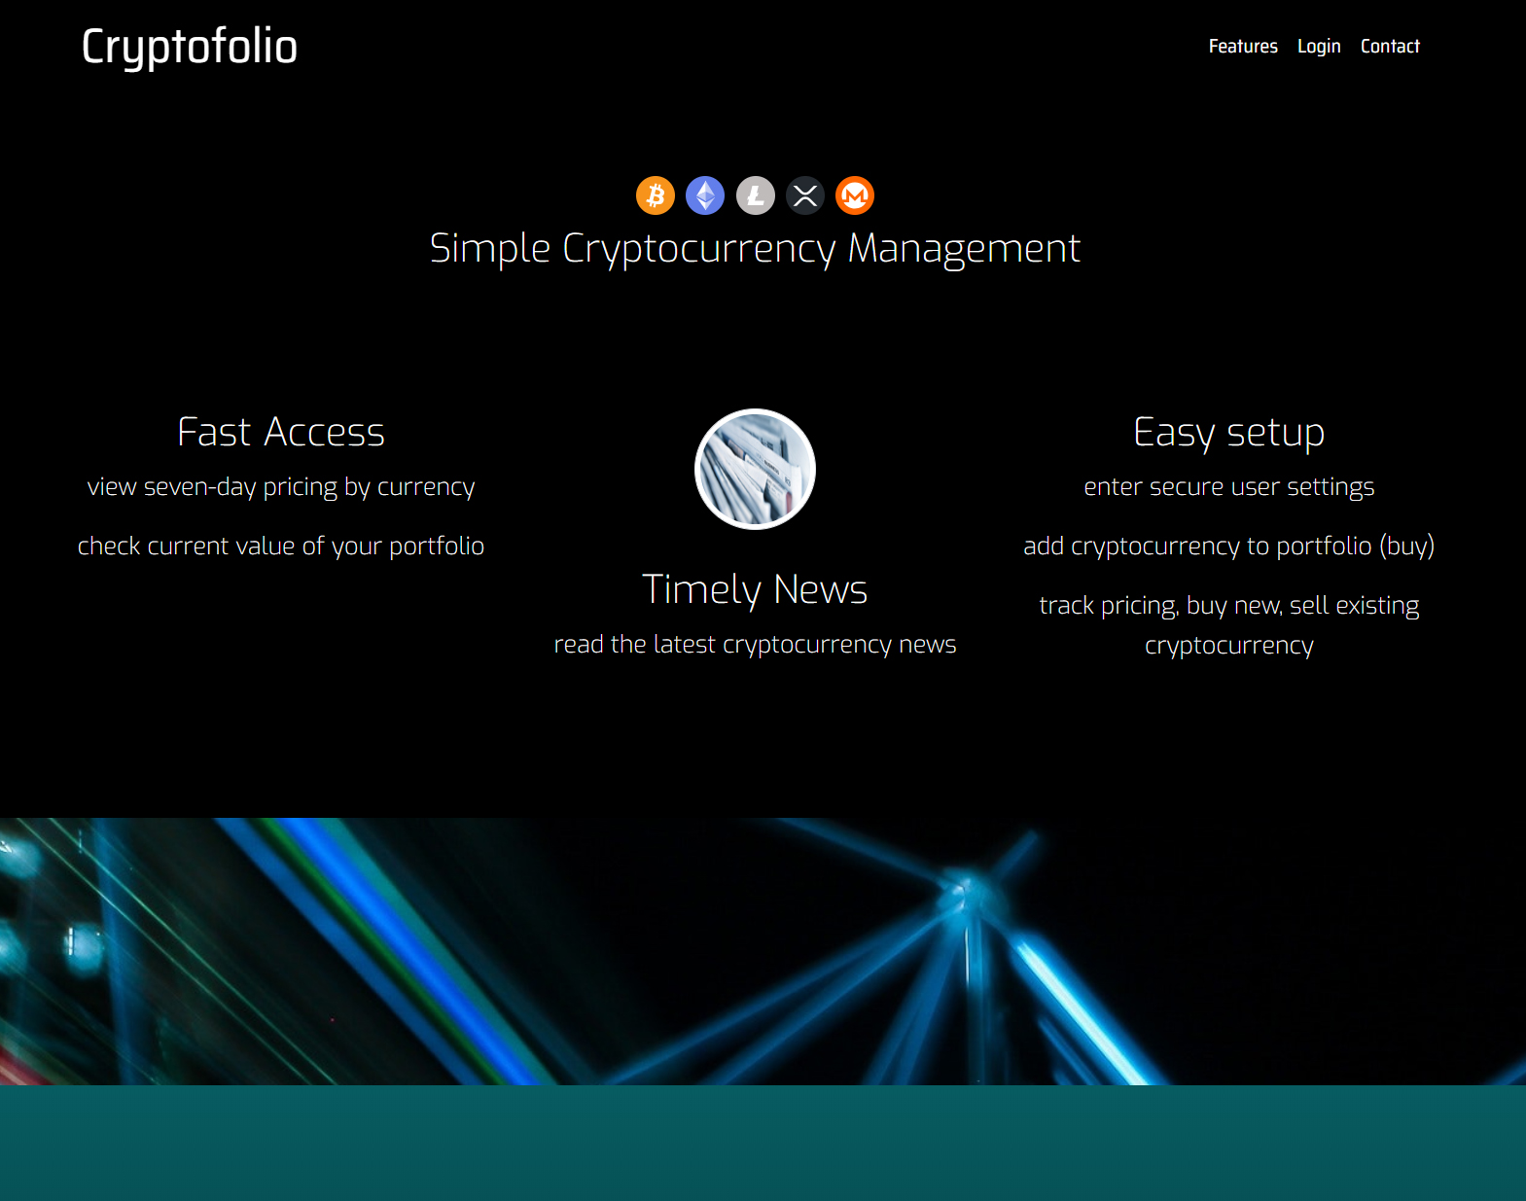
Project Demo

Slide 13
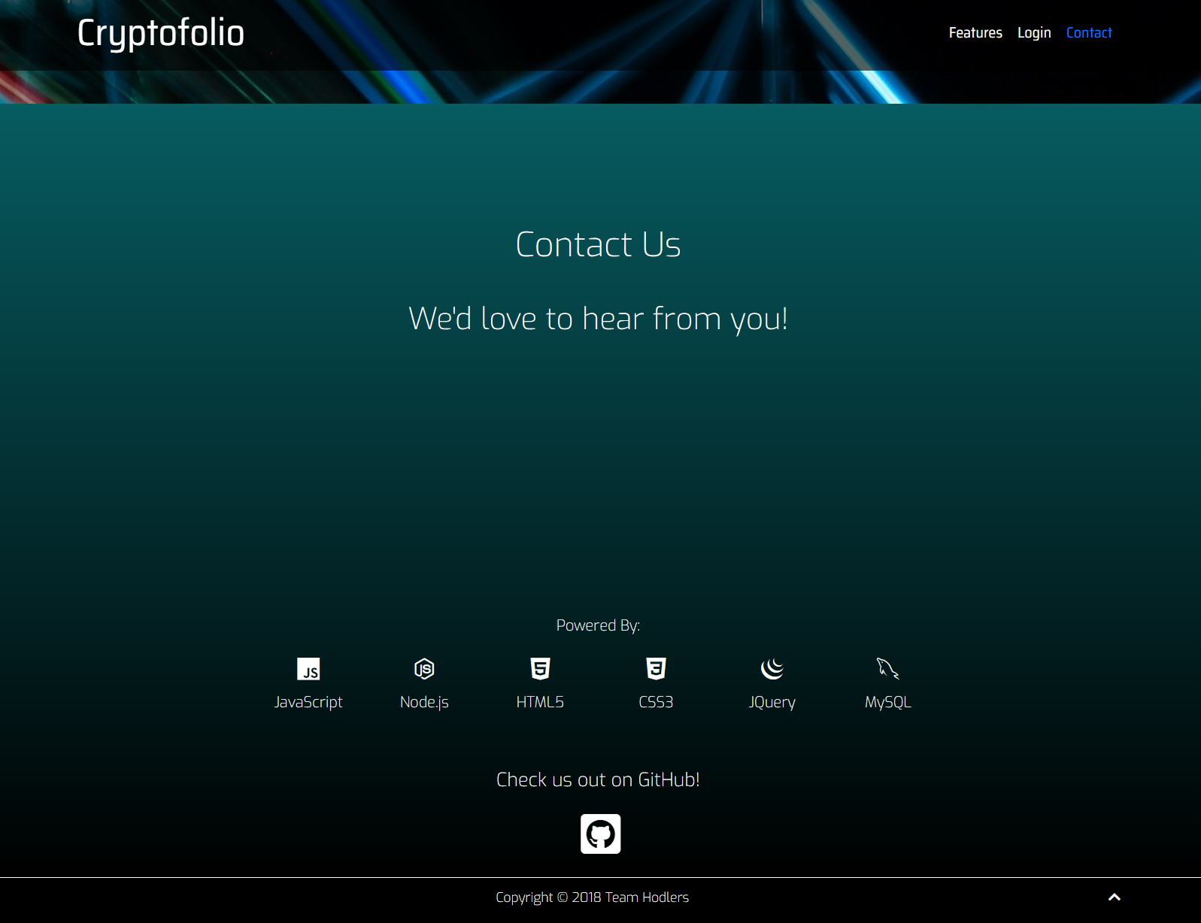
ThankS for Listening!
?
Q&A

